Slide 1
Sensor-Based Indoor Air Purification System Project Proposal

Slide 2
Contents
Introduction
Implementation Plan
Project Schedule
Expectations
Team Member Roles

Slide 3
Introduction
1

Slide 4
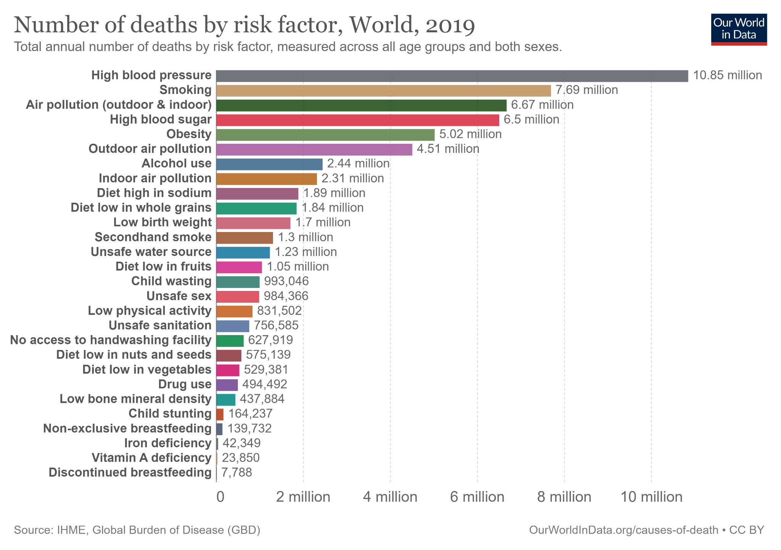
Poor indoor air quality caused 2.31 Million deaths in 2019.
That’s the 8th most common cause.

Slide 5
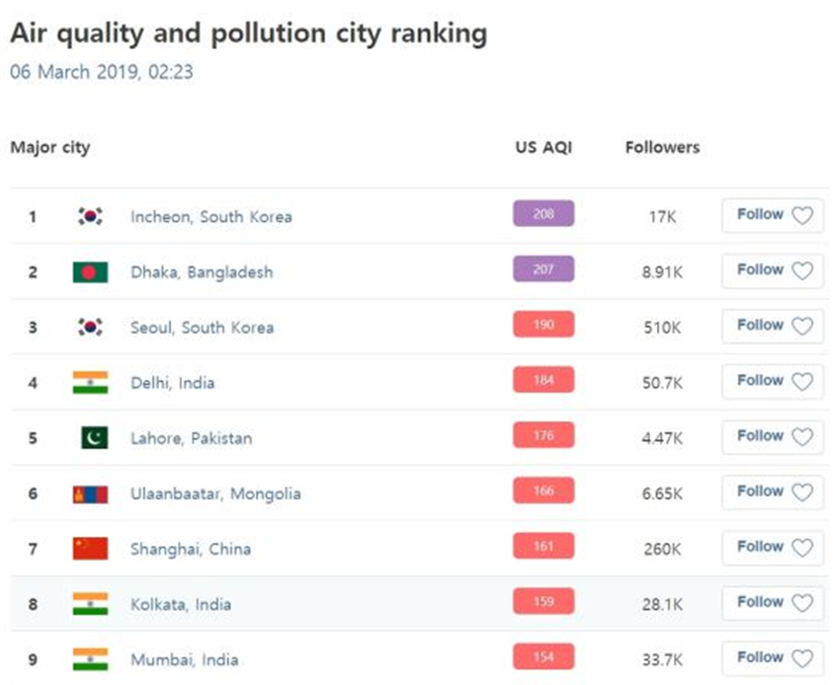
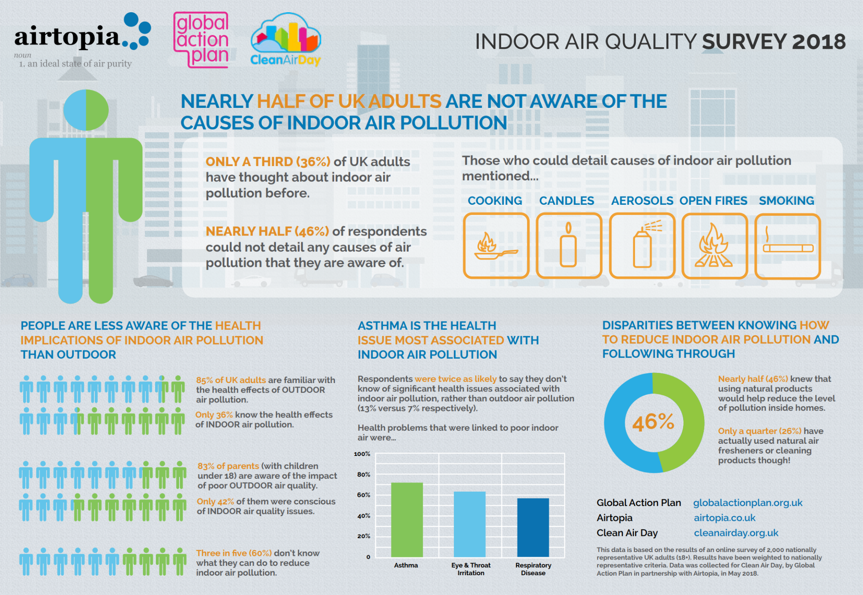
Trends in Air Pollution
Outside Air Pollution is Severe Worsening indoor air as well
Most People are Unaware Of Indoor Air Pollution

Slide 6
We Need Better
Indoor Air Quality!

Slide 7
What is ‘Good Indoor Air’
Temperature
Humidity
Indoor Air Quality
Indoor Air Pollution (IAP)

Slide 8
Our Product Will …
… Synchronize Data and Functionalities across Multiple Air Quality-Regulating Devices
… Be Fully Controllable and Monitorable by Mobile Device
… Maintain Optimal* Indoor Air Quality Fully Automated
*there is no absolute optimum for air quality, it can vary under different conditions

Slide 9
Implementation Plan
2

Slide 10
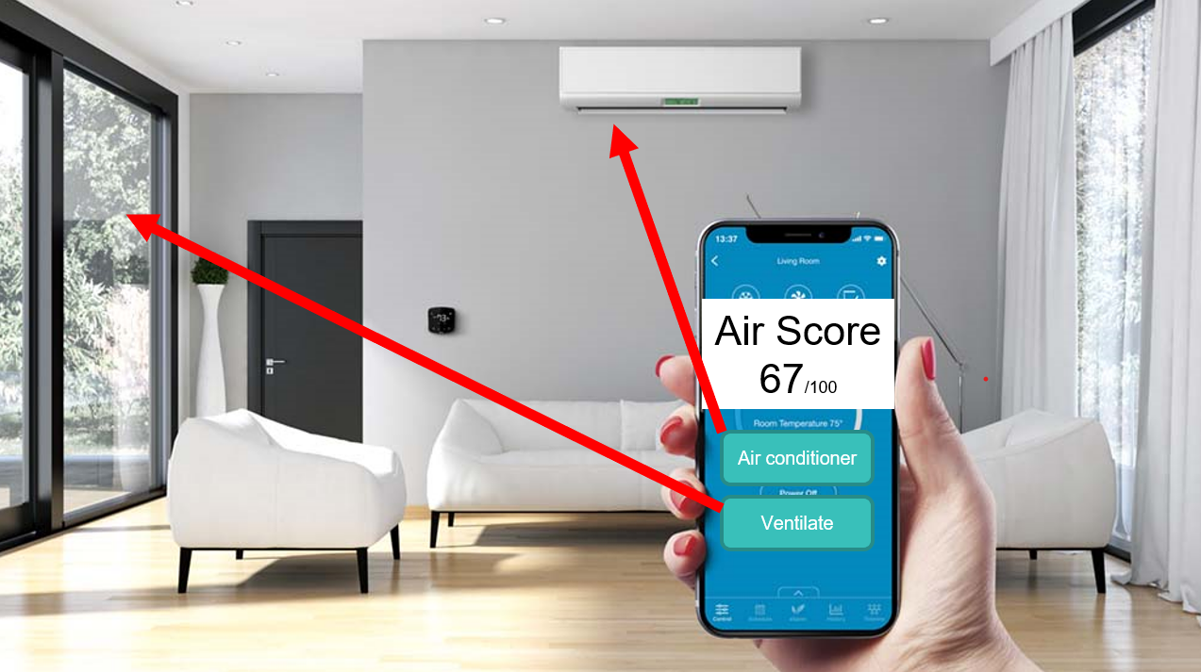

Slide 11







Different Components
Mobile App Development
System Development and Sensor Integration
Database

Slide 12
Project Schedule
3

Slide 13
Schedule
 |  | Timeline
 |  | ~3/27 | 3/27~4/3 | 4/3~5/8 | 5/8~5/29 | 5/29~6/12
Proposal
Specification | Requirement
 | Design
Development | Programming
 | Testing
 | Debugging
Validation | Component Testing
 | System Testing
 | Customer Testing
Evolution

Slide 14
Expectations
4

Slide 15
Expectations
Accessibility
Providing good air quality to elderly or children and in big buildings
Health Benefits
Improving respiratory health and preventing common diseases e.g. Asthma
Accident Prevention
Detecting anomalies e.g. fires and gas leaks during the absence of people through continued monitoring

Slide 16
Team Member Roles
5

Slide 17
The Team
UI/UX Designer
Jeongmin Cha (Team Leader) Joosun Baek
Application Developer
Seyeon Park Sungjoon Lee
System Developer
Jingyu Lee Hangyu Kim
Sever/DB Developer
Maike Helbig

Slide 18
Thank you!

